Slide 1

Google Cloud Hackathon
Revolutionizing Risk Assessment with GenAI
by Team Data Dynamo
Sneha Singh
Hariharan Macheri Kumar
Anurag Billaiya
Amit S Kulkarni​

Slide 2
Agenda
Problem statement
Risk Analysis using AI in Banking
Risk Profiles with Generative AI
Product Recommendation based on Risk Profile
Benefit of AI Implementation
Implementation & Demo
Challenges & Consideration
Future of GenAI based Risk Assessment

Slide 3
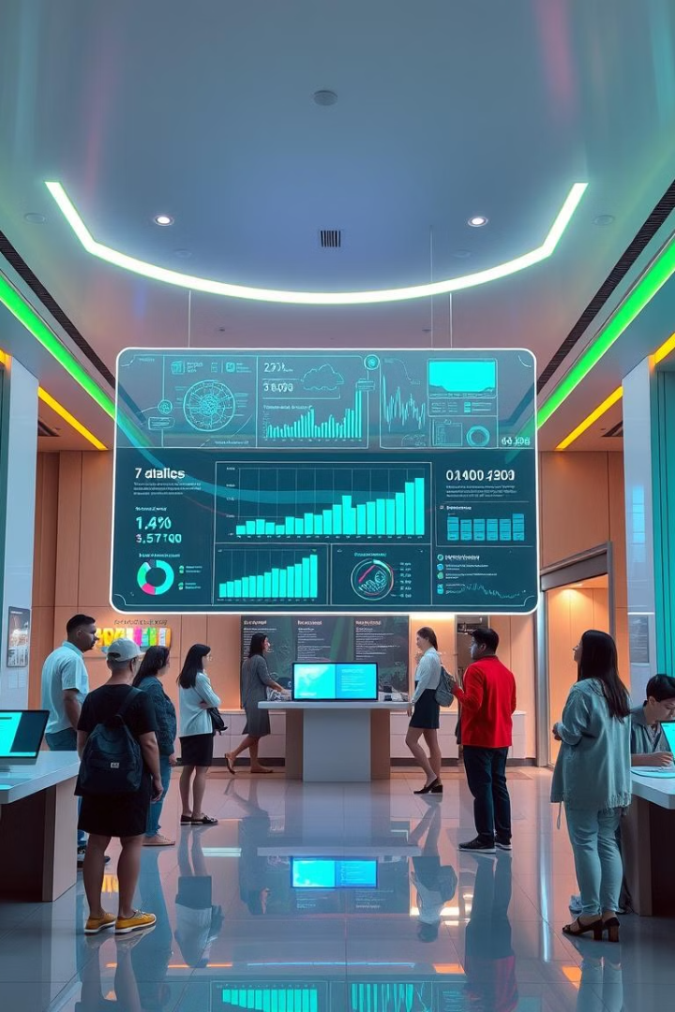
Problem Statement
Imagine a future where risk assessment is automated, efficient, and data-driven. Generative AI can revolutionize customer risk profiling, enhancing decision-making and personalized product offerings. By leveraging the power of AI, we can unlock a new era of financial innovation.

Slide 4
Risk Analysis using AI in Banking
Data Collection and Processing
Risk Profiling
Risk Prediction
The AI classifies customers into different risk profiles (high, medium, or low) based on their demographic and financial status. This segmentation enables targeted risk management strategies and personalized product offerings and report generation for future reference.
AI algorithms can predict future financial risks based on historical data and current trends. By anticipating potential risks, banks can proactively mitigate them and improve customer outcomes.
Generative AI models analyze vast amounts of customer data, including financial history, transactions, demographics, and external data sources, identifying patterns and correlations that traditional methods may miss.

Slide 5
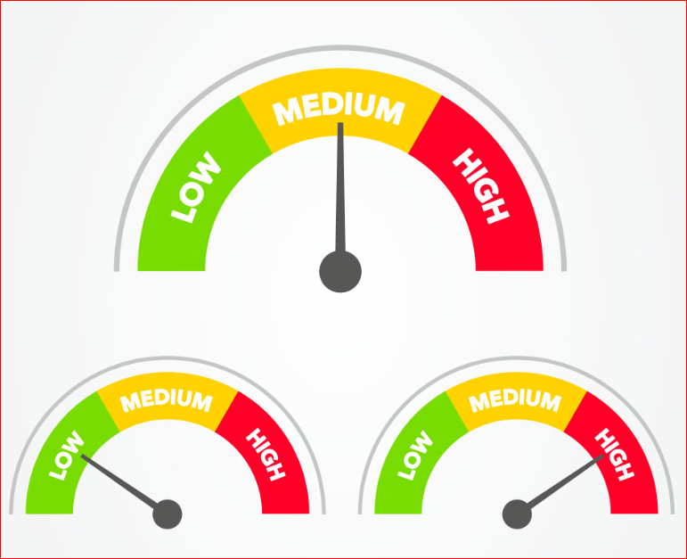



Risk Profiles with Generative AI
High Risk
Customers exhibiting high risk may be associated with factors like high debt, irregular income, and potential financial instability. This profile requires close monitoring and tailored risk mitigation strategies.
Medium Risk
Customers classified as medium risk fall between high and low risk. They may have moderate debt, stable income, and a balanced financial history. A balanced approach to risk management is recommended for this profile.
Low Risk
Customers with low risk typically exhibit strong financial health, including low debt, stable income, and a positive credit history. They may be eligible for preferential financial products and services.

Slide 6
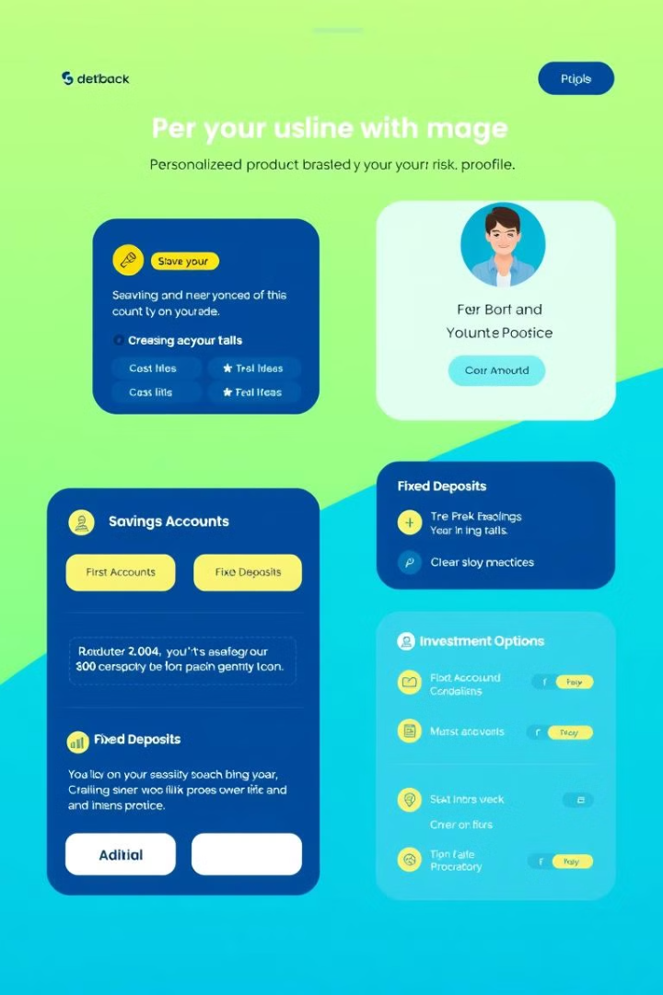
Product Recommendation based on Risk Profile
Savings Account
Customers with low risk profiles may be offered high-yield savings accounts, attracting higher returns on their deposits.
Fixed Deposit (FD)
Medium-risk customers may be recommended fixed deposits for guaranteed returns and capital preservation, offering stability and growth potential.
Equity
For high-risk customers, Equity linked product could be suggested as a way to diversify investments, mitigate risk, and build wealth over the long term.

Slide 7

Benefits of AI-Driven Risk Assessment
1
Improved Risk Management
AI-powered risk assessment enables banks to identify and address potential risks proactively, reducing exposure to financial losses.
2
Enhanced Customer Experience
Personalized product offerings and risk management strategies cater to individual customer needs, leading to greater satisfaction and loyalty.
3
Increased Efficiency and Productivity
Automation of risk assessment processes frees up human resources for more strategic tasks, enhancing operational efficiency and cost savings.
4
Data-Driven Decision Making
AI provides a wealth of data and insights, empowering banks to make informed decisions based on comprehensive analysis and predictive modeling.

Slide 8




Implementation and Demo
Solution Design
It consist the workflow and technical stacks of the solution.
POC
Demo
Demonstration of the POC.

Slide 9



Solution Design
Google Cloud
Vertex Studio
I am 32 years old with salary 25000/- and no liabilities
User Input

Slide 10
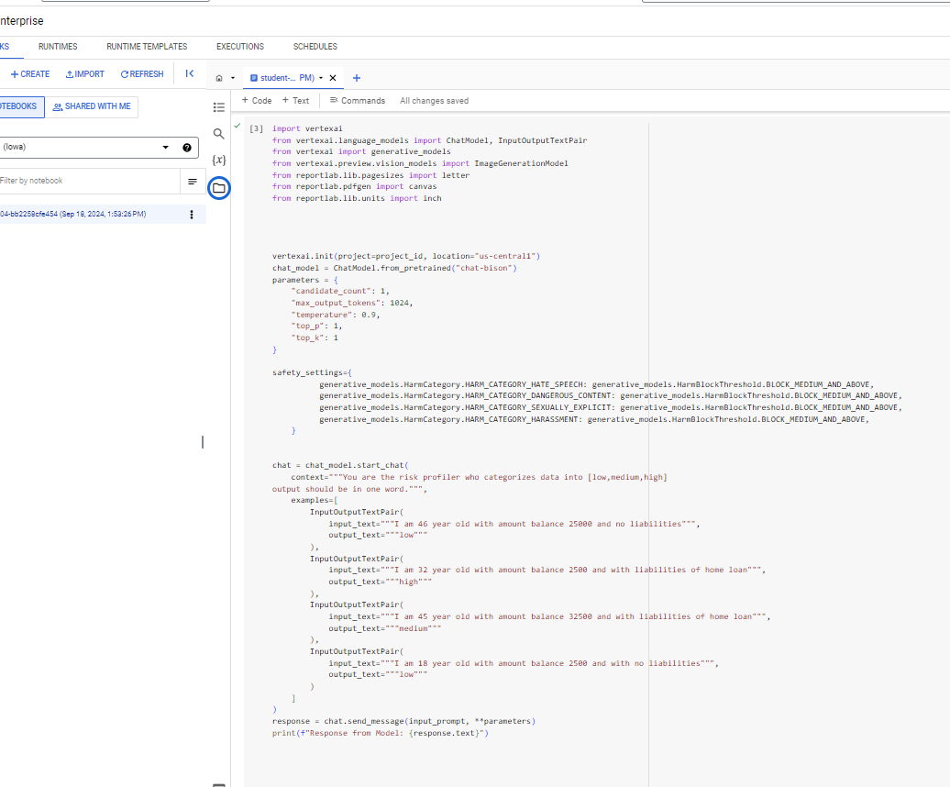
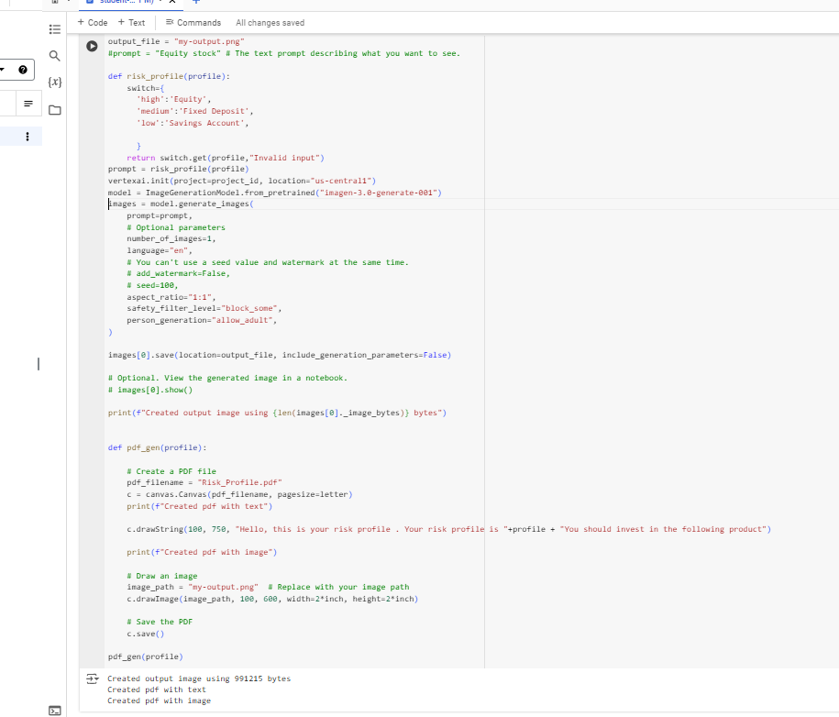
POC
Code Repository - https://github.com/hari010904068/hackathon_hsbc_risk_profiler
chat_model = ChatModel.from_pretrained("chat-bison")
model = ImageGenerationModel.from_pretrained("imagen-3.0-generate-001")

Slide 11
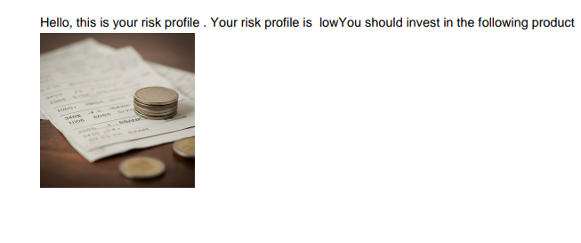

Output :
Risk_Profile_Report.pdf

Slide 12

Challenges and Considerations
1
Data Privacy and Security
Safeguarding customer data is paramount. Robust security measures and adherence to data privacy regulations are crucial for building trust and maintaining compliance.
2
Bias and Fairness
AI models can inherit biases from the data they are trained on. It is essential to address potential biases and ensure fairness in risk assessment outcomes.
3
Transparency and Explainability
AI decision-making processes should be transparent and explainable. Banks need to provide clear rationale for risk assessments and product recommendations to customers.
4
Human Oversight and Governance
AI should augment, not replace, human decision-making. Maintaining human oversight is crucial to ensure ethical and responsible use of generative AI in risk assessment.

Slide 13

The Future of Risk Assessment
Increased Automation
Greater Efficiency
Personalized Customer Experience
Advanced Predictive Analytics
Improved Risk Mitigation
Enhanced Financial Inclusion

